Slide 1

Celadon Simon Says Push-LED
University of Louisville
ECE-412 Fall 2014
Taylor Hans, Ricardo Benitez, Robert Cook, Austin Schroder

Slide 2


Game: Simon Says
User follows, memorizes, and attempts to enter correct push-LED sequence
LEDs are connected to J2 PORTA pins for generic output of the sequence, and the inputs are connected to J1/J3 PORTC and PORTD pins
No sound (YET!)

Slide 3

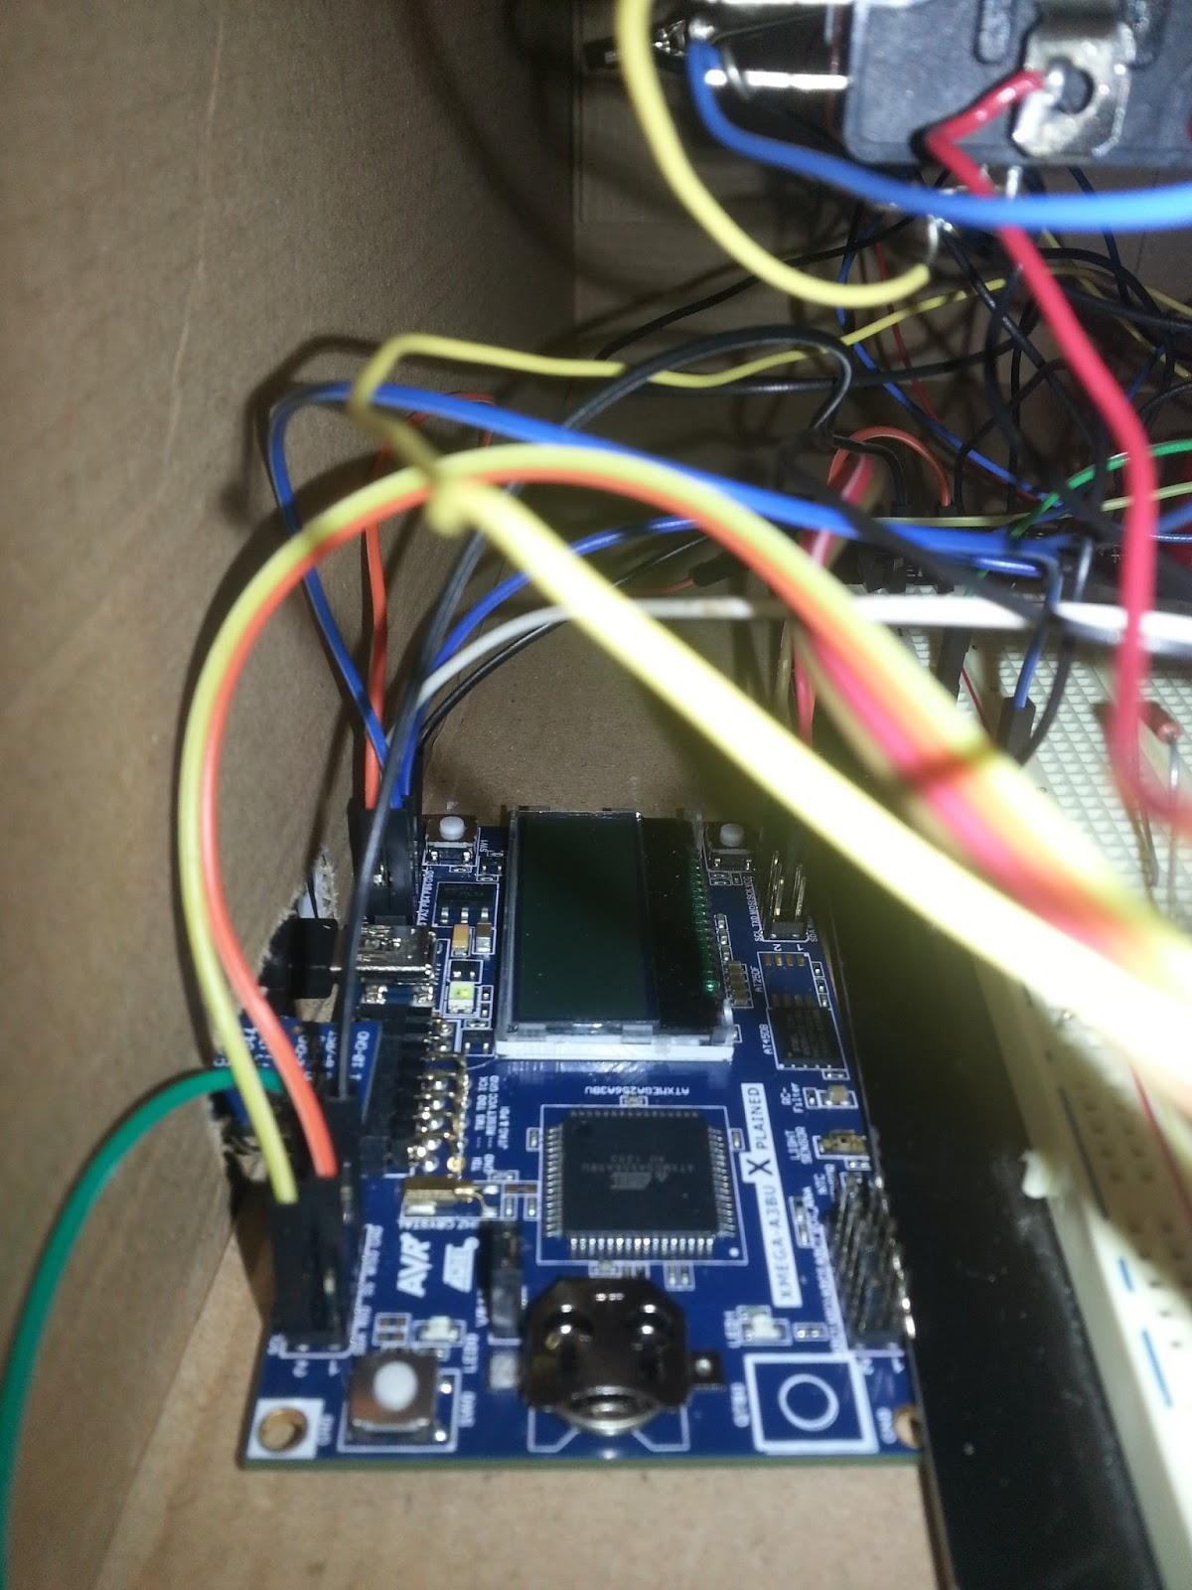
Under the Box: Interface
This shows the interface setup for the XPLAINED J expansion headers and PORTs used for both input and output connections for the game

Slide 4
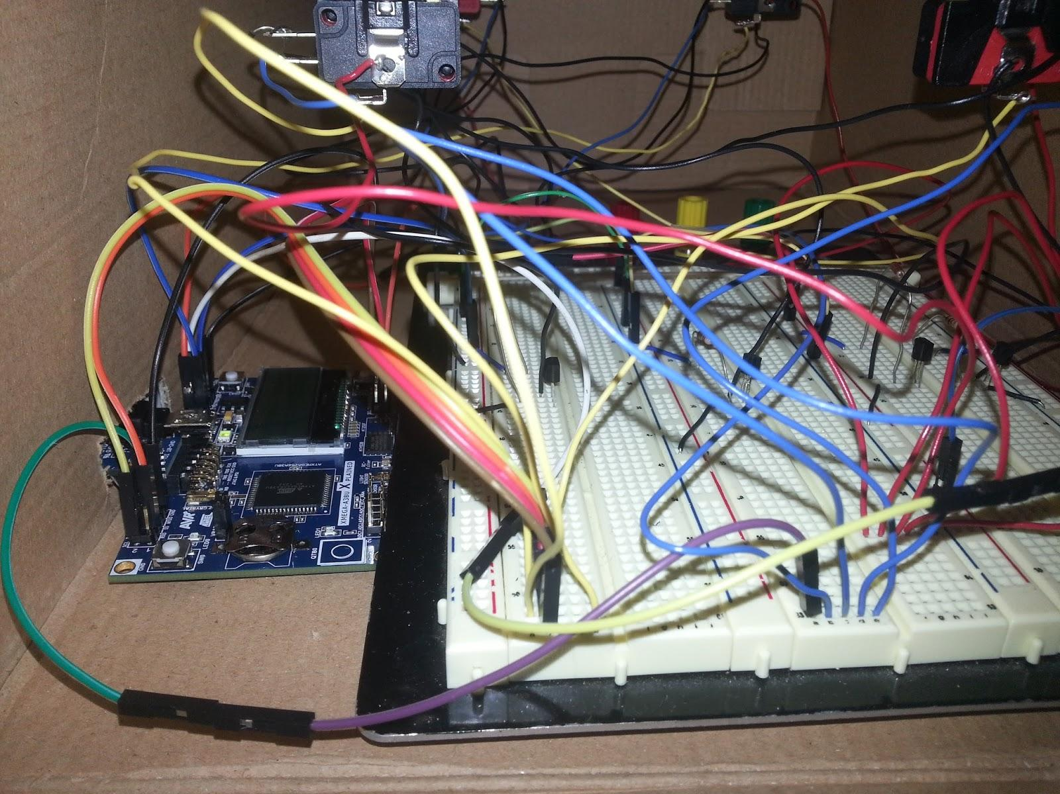
Under the Box: Circuit
Most of the loose wiring was due to needing to pull the A3BU pins to somewhere else, something that’s not easy to do tightly.

Slide 5
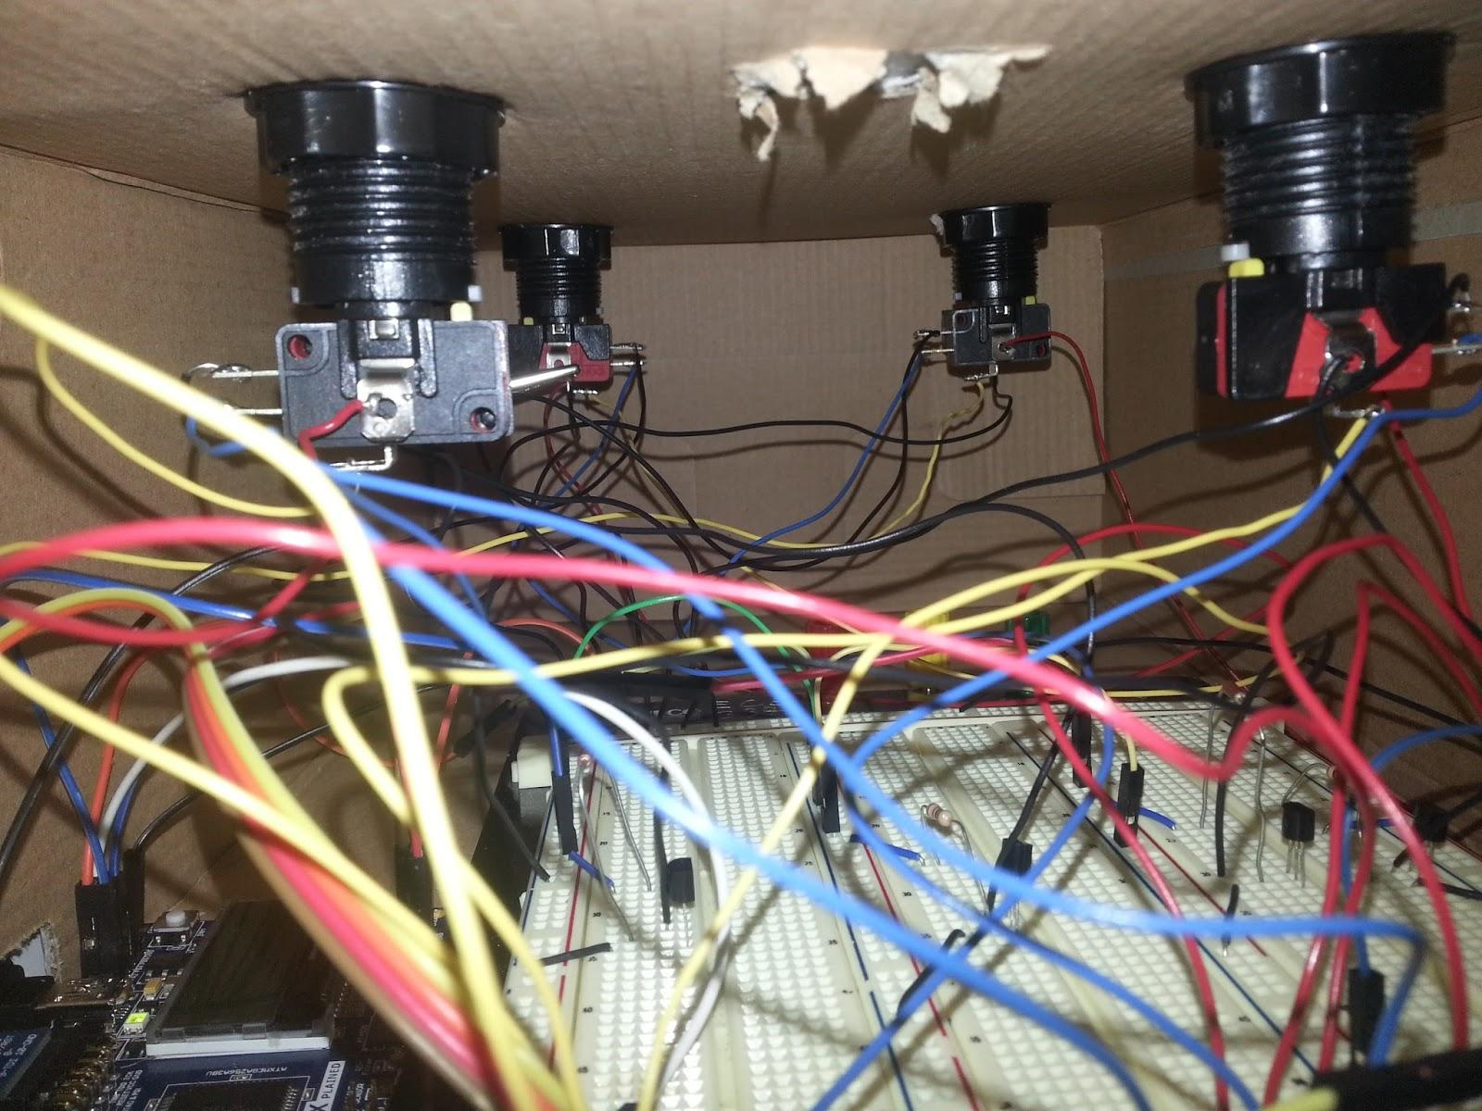
Under the Box: LED / Switch
This shows the wiring between the LEDs, switches, circuit, and bread board
It is directly underneath the top of the box where these are hooked up
Soldering, and a last minute clamp, was used to hold connections securely in place

Slide 6
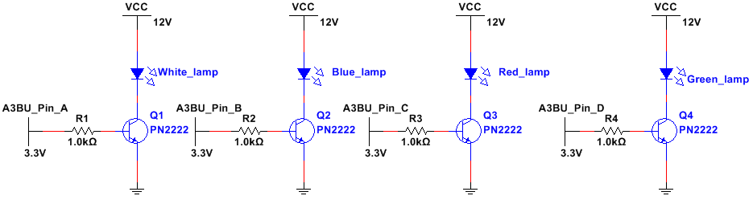
Just Duplicate this
Schematic: Output
Just

Slide 7

Schematic: Output/Input
For the output:
In this configuration, the Transistor behaves as a switch, completing the circuit when 3.3V is present at its base and turning the LED on. PN2222 transistors saturate when Collector/Emitter voltage is 1V.
The LED and its 12 VDC power supply are connected to the Collector of the transistor and the emitter goes to ground
For the input
The switches consist of three terminals: NO (normally open), NC (normally close), and common.
The common is connected to an input of the A3BU, normally closed goes to ground and normally open goes to 3.3V
Pressing the switch completes the circuit and it will send a signal to the A3BU

Slide 8
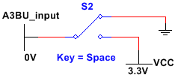
Microcontroller / Switch
Switch is momentary contact, Single Pole Double Throw (SPDT)
Normally Closed (NC) contact between A3BU input and ground
Normally Opened (NO) contact between A3BU input and VCC
Just

Slide 9
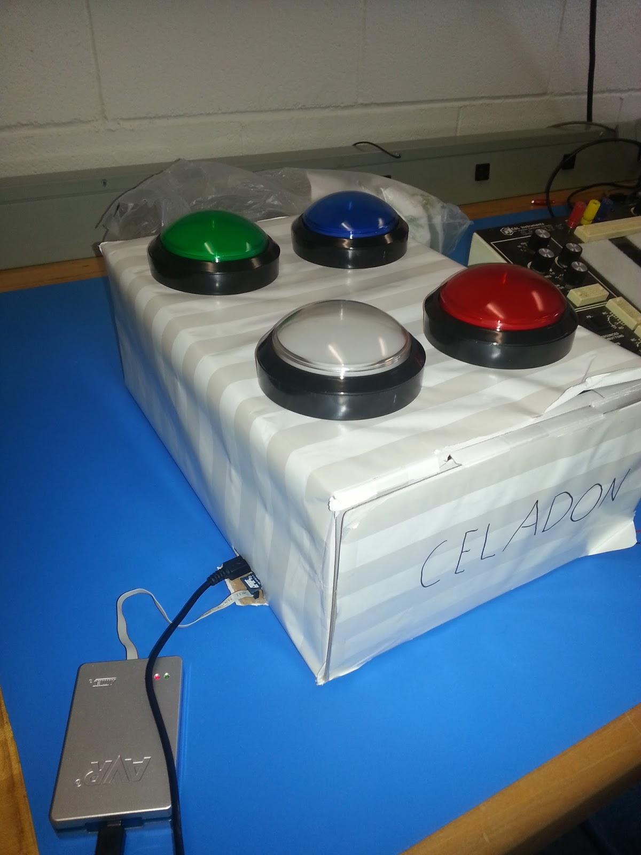
Finished Product: Debugging
The box allowed us to hide the wiring, plus an organized method for using the JTAGICE3 debugger to completely finish the game’s software

Slide 10


Problems Shortlist
Ran into a problem where the board wouldn’t accept nested loops/ifs - Would just ignore the loops or statements within the outer loop. Never did find a solution, but we moved the inside code to an external function, and it worked fine.
High score always tracked as double the correct number of points - We just halved the number of times the lights indicate a point to solve that problem.
At first, our interrupts wouldn’t let us determine which button caused the interrupt, so we spread the inputs across two ports so each button would have a different interrupt service routine, giving us exactly which button caused the interrupt.
A3BU got bricked when we tried to use PORTB for interrupts, which happened to be the same PORT the JTAG interface uses.
ZOMBIE LIGHT!

Slide 11
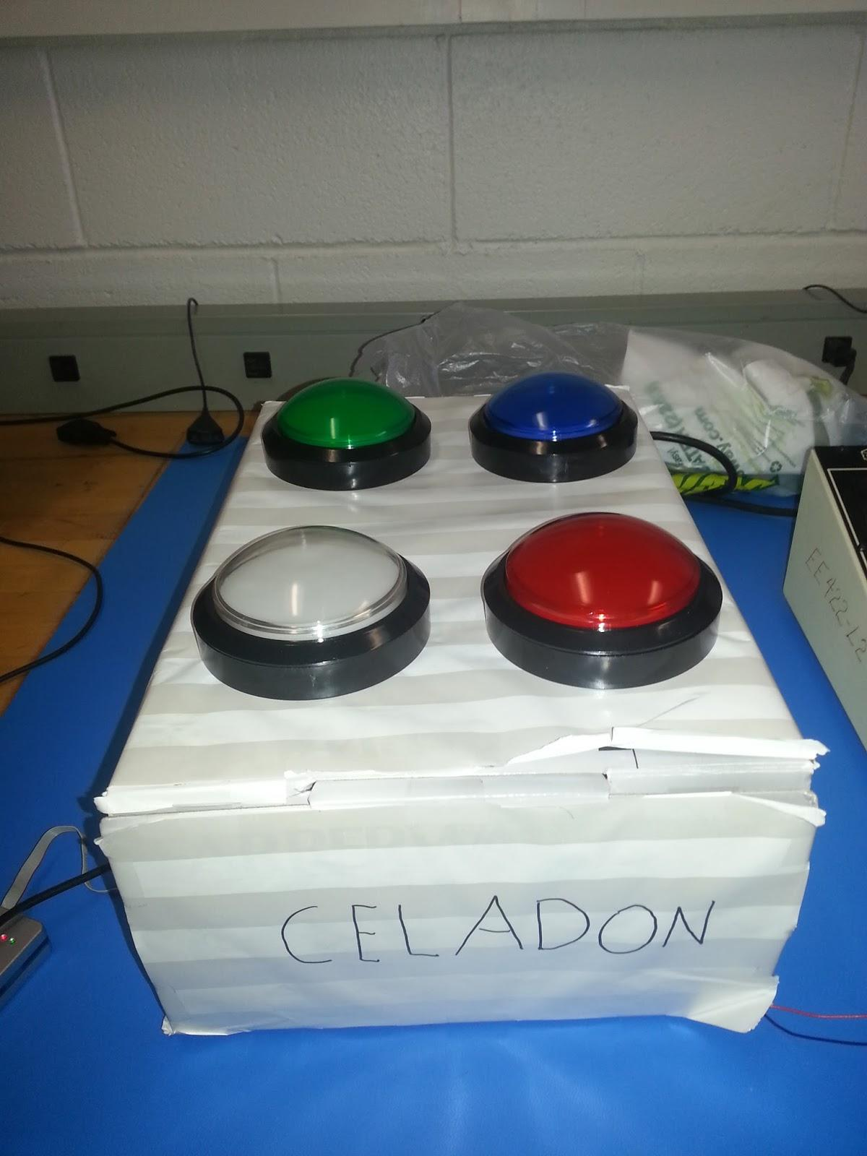
Finished Product: Instructions
In order to start the game push the green button, all the lights will turn on indicating that the game is about to start
The white button will flash the highscore (non-volatile through EEPROM)
The red button will reset the highscore
The blue button is to make the lights go crazy

Slide 12
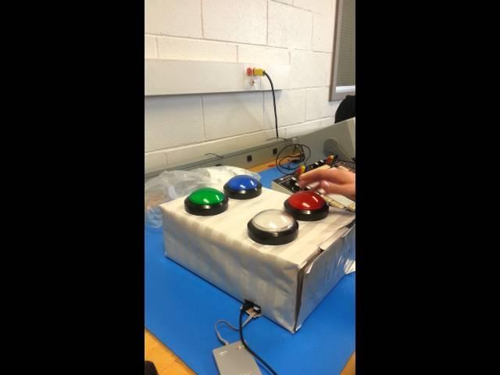
Video

Slide 13
References
PN2222 Datasheet
Dr. Harnett (University of Louisville) and her Electronics HW
GitHub Project Repository
Sparkfun-Switch-Basics
Sparkfun-Transistors
AVR-Interrupts
8/16-Bit Atmel XMEGA A3BU Microcontroller - ATxmega256A3BU
XMEGA A3BU XPLAINED Design Documentation
8-Bit Atmel XMega Microcontroller AU Manual

Slide 14



Questions?

